Slide 1
UNIT-1(Lesson 2)
Lists, Sets, Tuples

Slide 2

Lists
List is a data type of Python used to store multiple values of different types of data at a time. List are represented with []. A list can be created by putting comma separated values between square brackets []. The following program shows creation of two lists namely list1 and list2 :
Values stored in the list are accessed using an index. Index range between 0 to n-1, where n is the number of values in the list Python allows negative indexing for lists. The index of -1 refers to the last value of the list, -2 refers to the second last value of the list and so on.

Slide 3
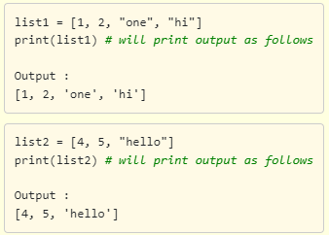
Printing lists: The lists can be printed using the in-built function print() as shown below.

Slide 4
Sets
A set is a mutable data type that contains an unordered collection of items.
Every element in the set should be unique (no duplicates) and must be immutable (which cannot be changed). But the set itself is mutable. We can add or remove items / elements from it.
Example: {1,2,3,4,”a”}
Dictionary is not mutable nor immutable.

Slide 5
Tuples
A tuple is a data type similar to list.
The major differences between the two are: Lists are enclosed in square brackets [] and their elements and size can be changed (mutable), while tuples are enclosed in parentheses () and their elements cannot be changed (immutable).
Example: (1,2,3,4,”a”)

